Slide 1

Python Overview
Data Science Technologies

Slide 2
Learning Outcomes
Python Overview
Python Data Types
Python Functions
Python Variable

Slide 3
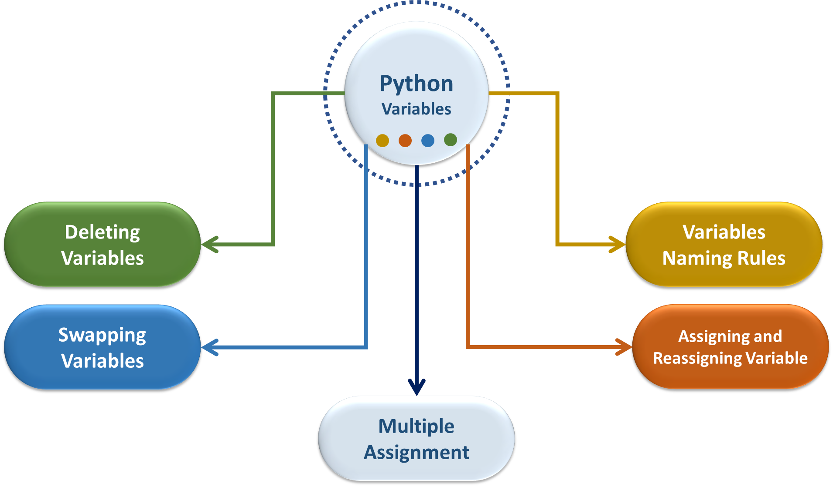
Python Variables

Slide 4
Python Variables
Container for a value
Assigned a name

Slide 5
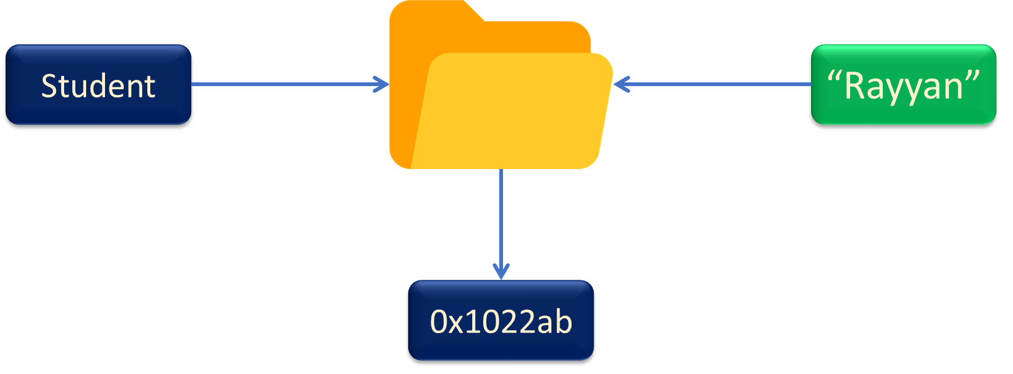
Variables Example
Age, Num, Name, City

Slide 6
Variables Naming Rules

Slide 7
Begin with (A-Z/a-z) or ( _ )
For Example:
age=18
print(age)
Output: 18

Slide 8
Begin with (A-Z/a-z) or ( _ )
For Example:
_9lives='cat’
print(_9lives)
Output: cat

Slide 9
Rest of (A-Z/a-z), ( _ ) or (0-9)
For Example:
City42=‘Lahore’
print(City42)
Output: Lahore

Slide 10
Rest of (A-Z/a-z), ( _ ) or (0-9)
For Example:
_$$ = 8
print(_$$)
Output: invalid syntax

Slide 11
Python is case-sensitive
For Example:
city=‘Lahore’
print(city)
print(City)
Output: Lahore
Output: name ‘City’ is not defined

Slide 12
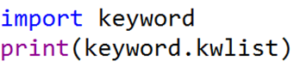
keywords can’t be used

Slide 13
Assigning and Reassigning Python Variables

Slide 14
Assigning and Reassigning Python Variables
age=42
print(age)
age='Lahore'
print(age)
Output: 42
Output: Lahore

Slide 15
Multiple Assignment
city1, city2=‘Multan’, 'Lahore'
print(city1, city2)
Output: Multan Lahore

Slide 16
Multiple Assignment
age=days=7
print(age, days)
Output: 7 7

Slide 17
Swapping Variables
a, b='red’, 'blue'
a, b = b, a
print(a, b)
Output: Blue , Red

Slide 18
Deleting Variables
age=21
del age
print(age)
Output: name ‘a’ is not defined

Slide 19
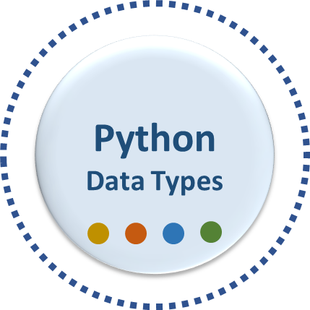
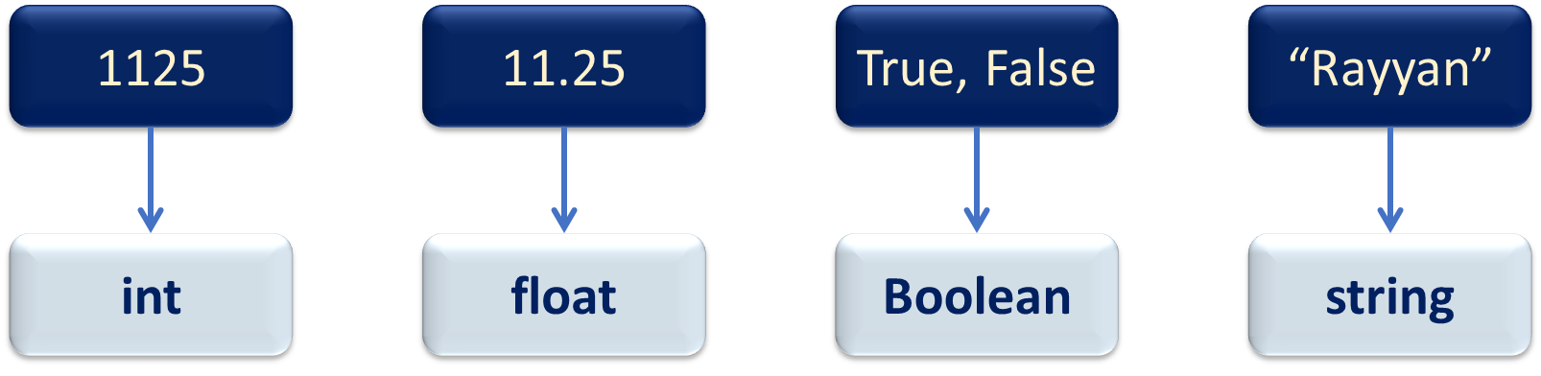
Python Data Type

Slide 20
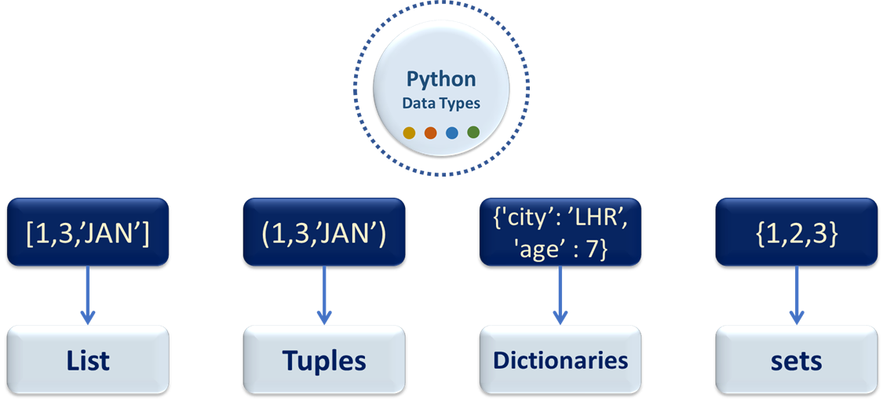
Python Data Type

Slide 21
Variables Naming Rules
keywords can’t be used

Slide 22
Variables Naming Rules

Slide 23
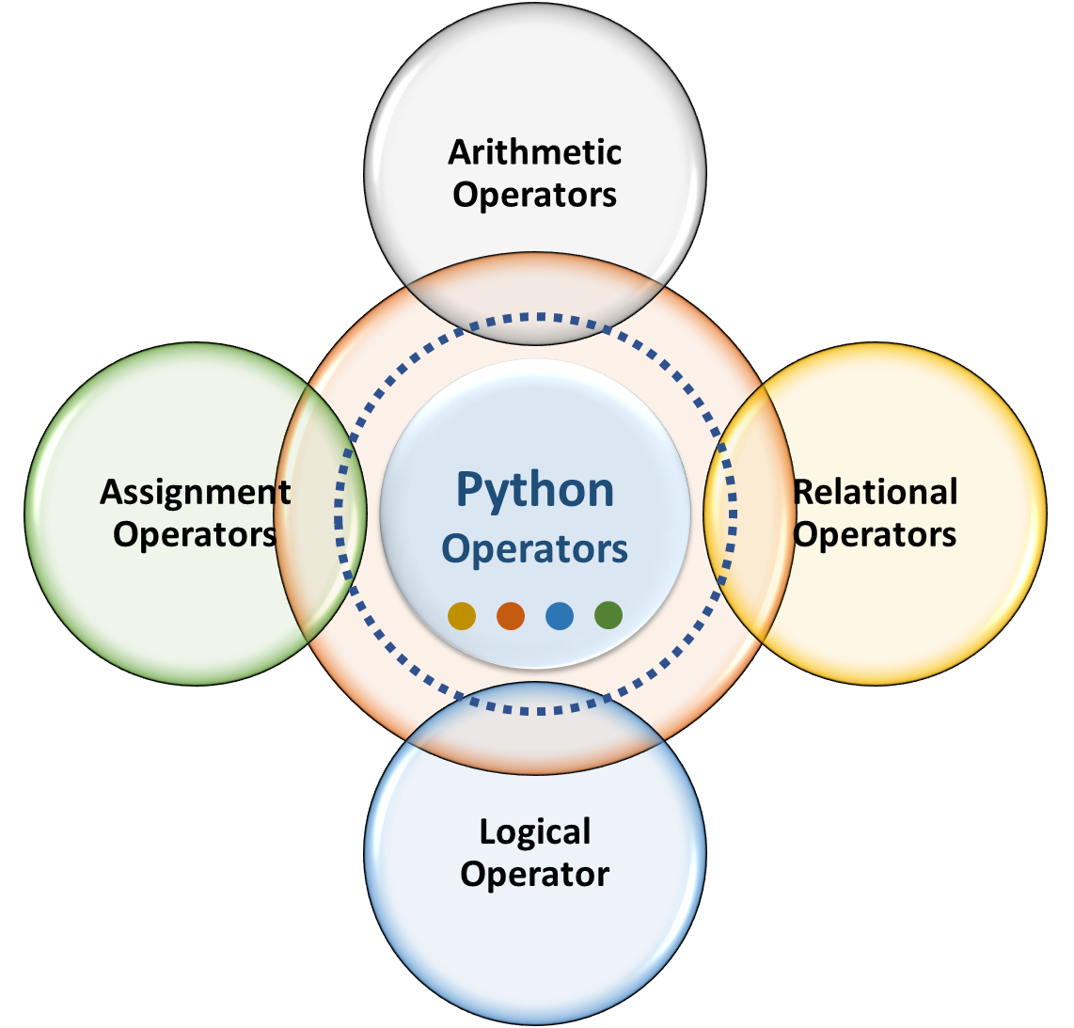
Python Operators

Slide 24
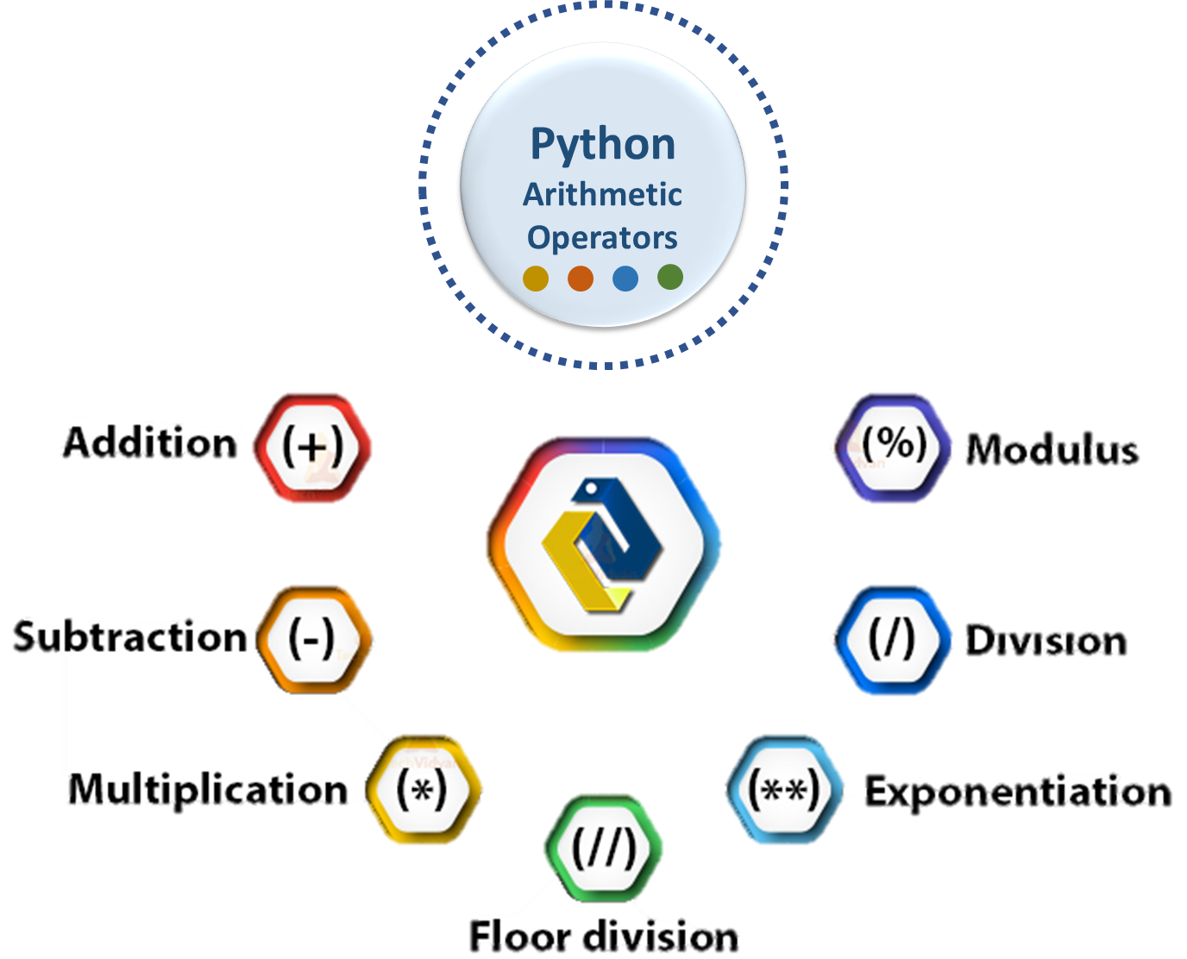
Arithmetic Operators

Slide 25
Arithmetic Operators

Slide 26
Arithmetic Operators

Slide 27
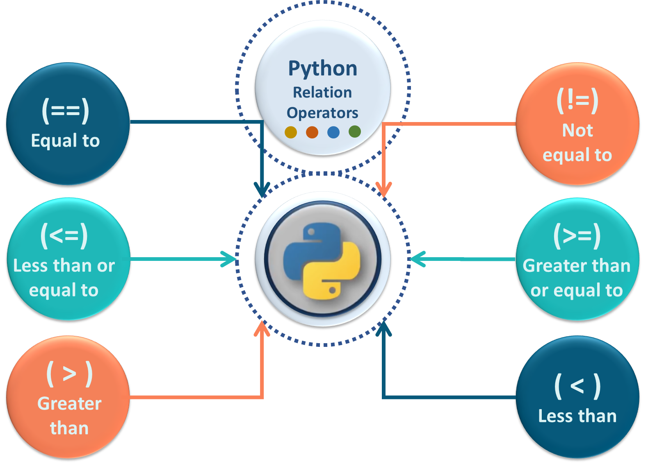

Slide 28
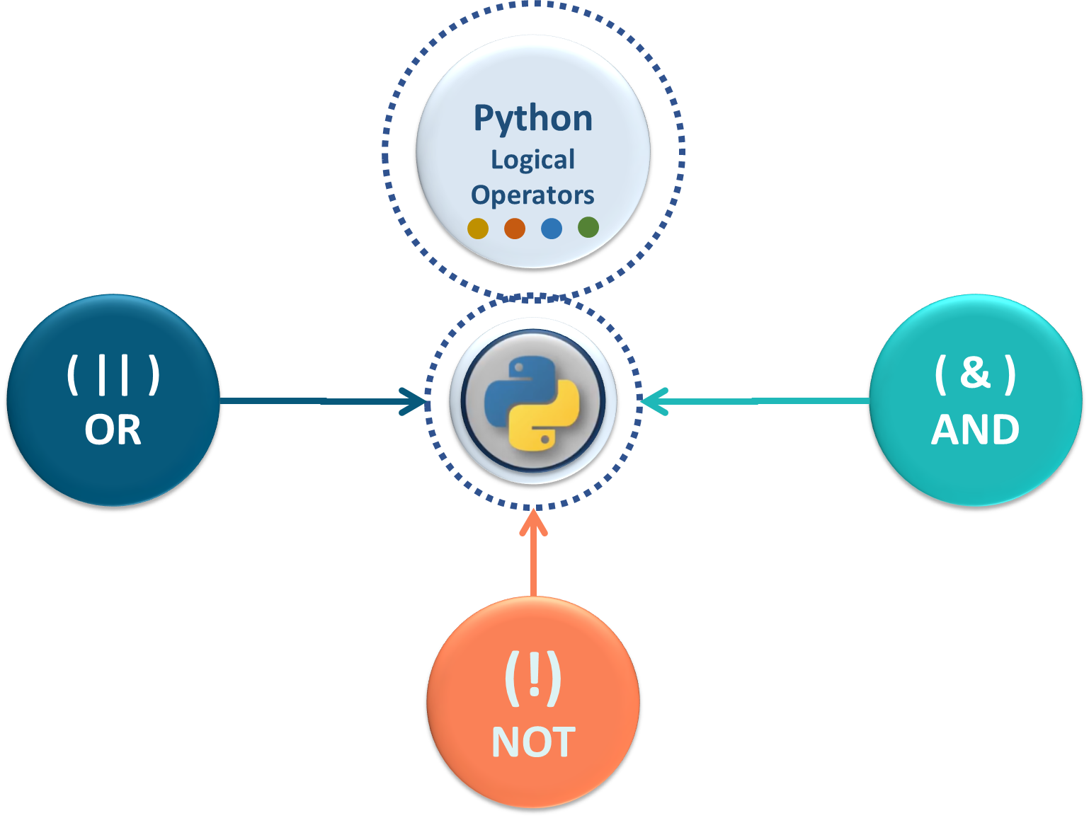

Slide 29
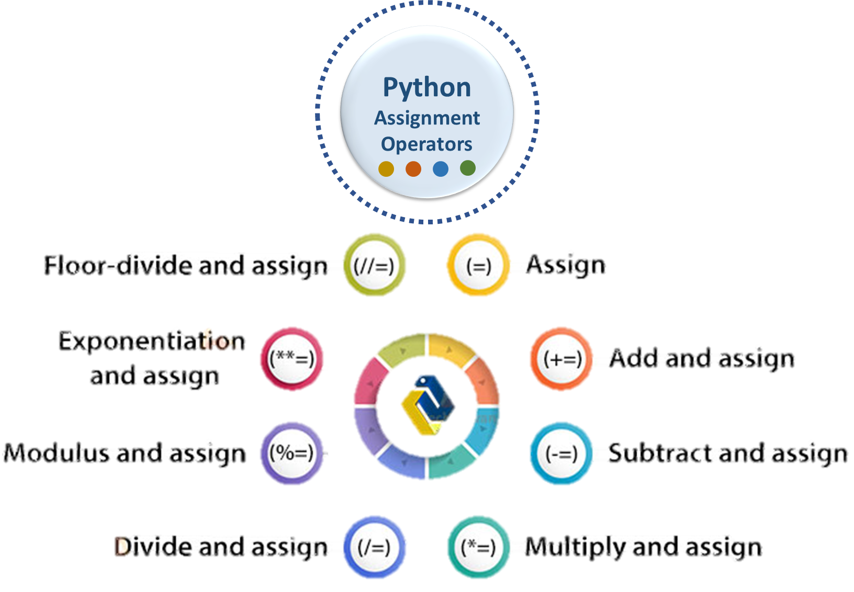

Slide 30
Python Data Type

Slide 31
Python Data Type

Slide 32
Python Operators

Slide 33
Arithmetic Operators

Slide 34
Relational Operators

Slide 35
Logical Operators

Slide 36
Assignment Operators

Slide 37
Python Functions

Slide 38
Some built-in functions
chr | chr(65) | A
ord | ord('A') | 65
round | round(2.3465, 2) | 2.35
abs | abs(-23) | 23

Slide 39
User-Defined Functions

Slide 40
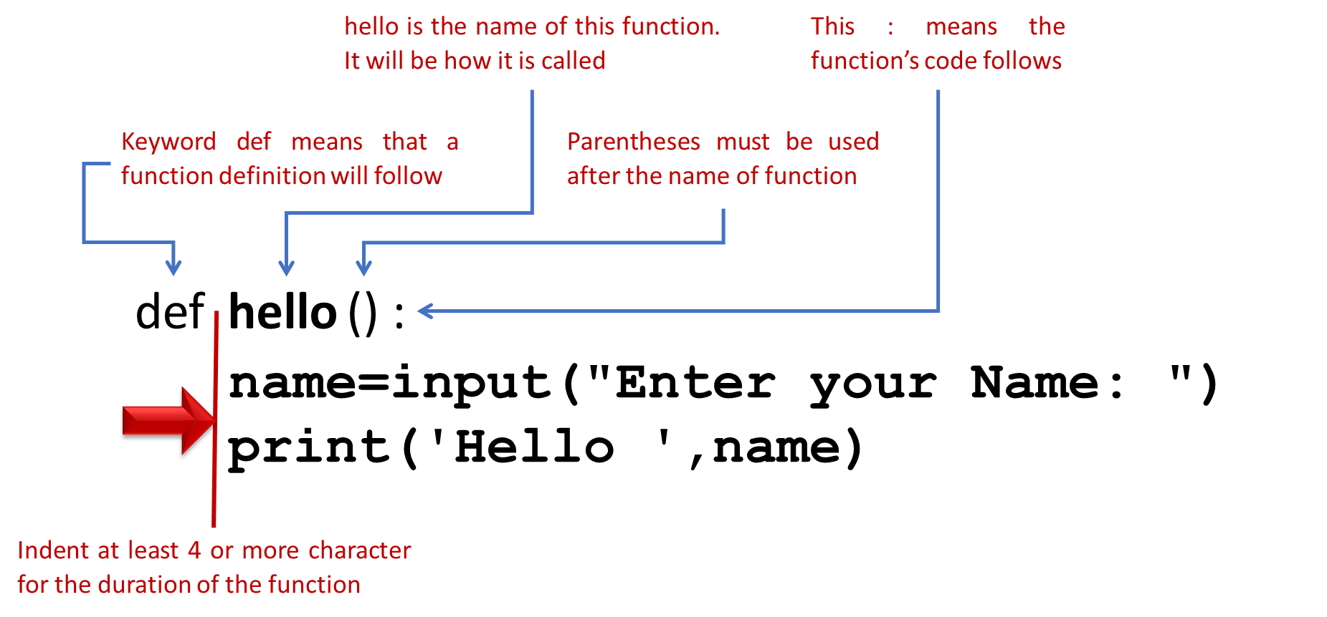

Slide 41
Defining & Calling python function
def hello():
name=input("Enter your Name:")
print('Hello ',name)
hello()

Slide 42
Parameters & Arguments

Slide 43
Parameter
A parameter is the variable listed inside the parentheses in the function definition.
def Happy_Birthday(person):

Slide 44
Argument
An argument is the value that is sent to the function when it is called.
Happy_Birthday(name)

Slide 45
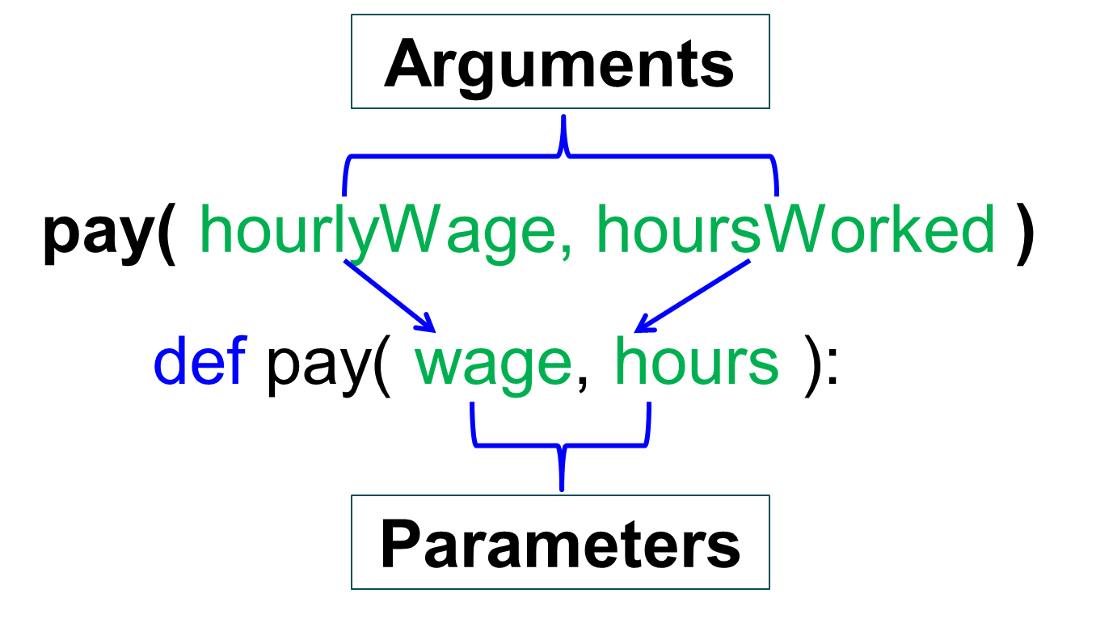
Parameters & Arguments

Slide 46
Lambda Function

Slide 47
Lambda Function
It is anonymous
It defined without name
And without def keyword
numbers of Arguments
Only one expression

Slide 48
Lambda Function Syntax
lambda arguments : expression

Slide 49
Lambda Function Example
add function
def add (x, y):
return x+y
lambda function
add = lambda x, y : x+y
Call the function
print(add(4,11))

Slide 50
Arguments
pay( hourlyWage, hoursWorked )
def pay( wage, hours ):
Parameters

